Slide 1
Foundations for Excellent Teaching AALS Workshop for New Teachers
Howard Erichson, Moderator
David Super
Olympia Duhart June 7, 2024
Notes:
30 min per speaker

Slide 2
Pedagogical Caring in the Law School Classroom
Olympia Duhart
AALS Workshop for New Law Teachers
June 7, 2024

Slide 3
“The new developmental research suggests that our unique evolutionary trick, our central adaptation, our greatest weapon in the struggle for survival, is precisely our dazzling ability to learn when we are babies and to teach when we are grown ups.”
-- Alison Gopnik, Andrew N. Meltzoff & Patrick K. Kuhl
The Scientist in the Crib

Slide 4
A Case for Caring in the Law school Classroom

Slide 5
Literature Summary
Brainstorming Activity
Questions and Answers
Creating a Culture of Caring

Slide 6
Literature Summary

Slide 7
Pedagogical Caring
Well-being
Engagement
Practice Preparation
Positive Emotions & Learning
Professional Identity
Motivation

Slide 8
“Please do not give up on me in this class.”
Notes:
From Thomas Hawks’ Student (10 weeks into a 15 week class)

Slide 9
Student Survey
Thomas F. Hawk &
Paul R. Lyons
Signs Faculty Cared
Signs faculty did Not care
Instructor was prepared for class
Instructor was enthusiastic about the subject
Instructor had high standards for student performance
Instructor gave frequent feedback
Instructor was available to students after class
Instructor used other students as a resource
Instructor simply lectured with no participation
Instructor showed no enthusiasm for the course material
Instructor showed no interest in students
Instructor bolted as soon a class ended
Instructor was impatient with questions
Instructor only taught to those more advanced in the class
Instructor held parties instead of class and gave free rides to everyone
Notes:
Excerpt from Please Don’t Give Up on Me: When Faculty Fail to Care, Thomas F. Hawk & Paul R. Lyons (2008); Six semesters in an MBA Program (+200 students)

Slide 10
Pedagogical Caring
Coming to Class Prepared
High Expectations
Getting to Know Students
Creating Community
≠BFF
Notes:
Scale, but caution to maintain professional boundaries.
See Thomas Hawk and Paul Lyons

Slide 11
Motivation Essentials
Autonomy
Belonging
Competence
Self-determination theory advanced by motivation researchers Edward Deci and Richard Ryan.
Notes:
Motivation researchers Edward Deci and Richard Ryan. Positioning students for intrinsic motivation.

Slide 12
Learning Theory
Novelty
Specific Feedback
Room to Fail
Problem-solving
Social Brain
Positive Emotions
Constructivism
Notes:
Andi Curcio’s study in 2008-2009 of FA and Self-Reflective Exercises in an Evidence Class. Study published at 61 J Legal Educaiton 379 (2012).
We experience reward through social interaction

Slide 13
Novelty
Neuroscientists have recently begun to track the relationship between curiosity and motivation more directly. The human brain’s “innate biological need for novelty” is fueled by curiosity.
-- Joshua R. Eyler,
How Humans Learn
Notes:
Therefore, effective course design and teaching strategies that leverage creativity can promote deep learning.

Slide 14
Creating a Culture of Caring in the Classroom
Artifacts
Autonomy
Assessment
Accountability
Community

Slide 15
Artifacts
Notes:
A photograph of Elizabeth Eckford attempting to enter Little Rock School on 4th September, 1957. The girl shouting is Hazel Massery. See Little Rock Nine for context.
Cooper v Aaron

Slide 16
Notes:
The case began in January 2002 when Joseph Frederick, an 18-year-old student at Juneau-Douglas High School in Alaska, unfurled a 14-foot banner with the message “Bong Hits 4 Jesus” as the Winter Olympics torch relay passed by a public street near his school. Frederick had skipped school that day, intent on displaying his message before television cameras.
Morse v. Frederick

Slide 17
Autonomy
Build your own syllabus
Collaboration Options
“Optional” writing assignments
“Optional” review sessions
Essay choice on final

Slide 18
Accountability
ABA Standard 302 (Self-evaluation as a Learning Outcome)

Slide 19
ABA Standards 302 and Interp.
Standard 302. LEARNING OUTCOMES A law school shall establish learning outcomes that shall, at a minimum, include competency in the following: (a) Knowledge and understanding of substantive and procedural law; (b) Legal analysis and reasoning, legal research, problem-solving, and written and oral communication in the legal context; (c) Exercise of proper professional and ethical responsibilities to clients and the legal system; and (d) Other professional skills needed for competent and ethical participation as a member of the legal profession.
Interpretation 302-1 For the purposes of Standard 302(d), other professional skills are determined by the law school and may include skills such as, interviewing, counseling, negotiation, fact development and analysis, trial practice, document drafting, conflict resolution, organization and management of legal work, collaboration, cultural competency, and self-evaluation.
Notes:
Connect explicitly to cognitive protocols and other self-reflection activities.

Slide 20
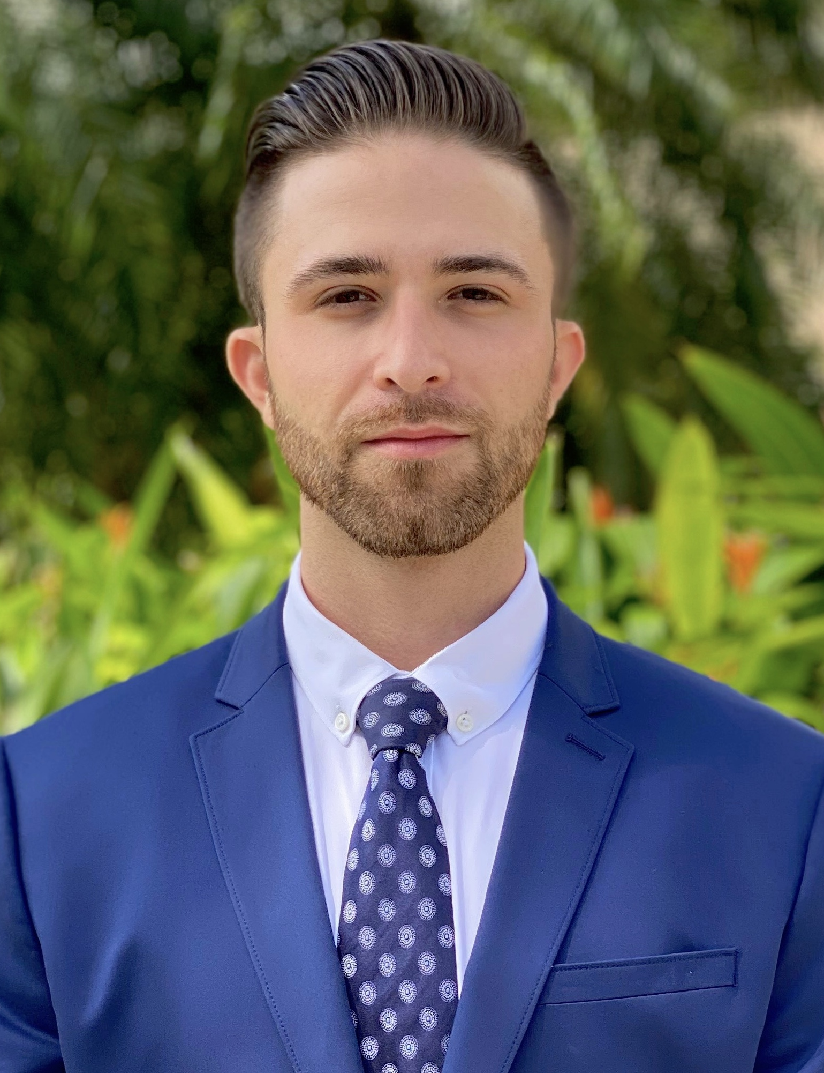
Jonathan Bornstein, ESQ.
Judicial Law Clerk for Honorable Judge Damoorgian, Fourth District Court of Appeals of Florida

Slide 21
Assessment

Slide 22
ASSESSMENT Retrieval practice: 5 Minute Miracle
Notes:
First Five Minutes or Last Five Minutes: Predicting and Retrieving
Offer the index cards
Credit: James Lang

Slide 23
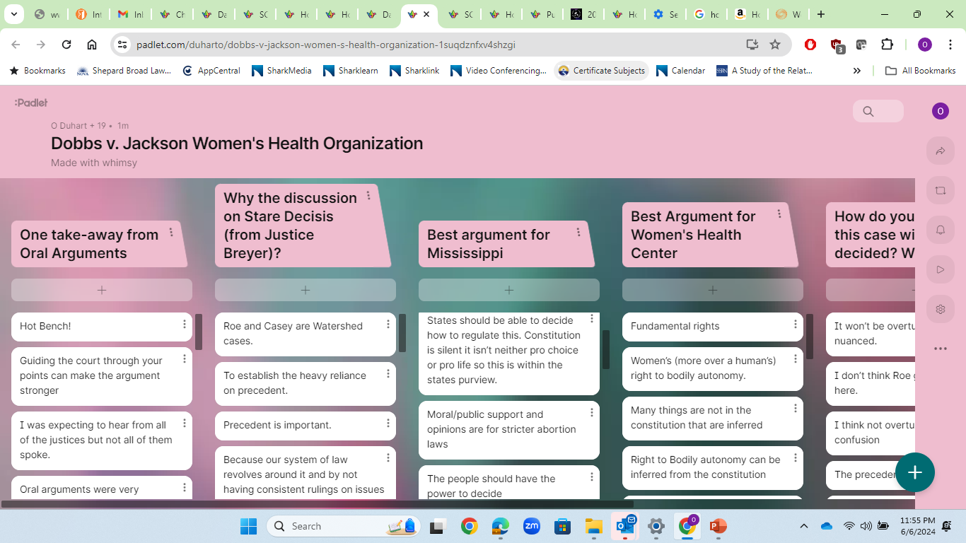
Notes:
Padlet – easy to use tech that relies on cellphones for quick formative assessment

Slide 24
1st A
Incitement to violence
Fighting Words
Obscenity

Slide 25
Mahanoy Area School District v. B.L.

Slide 26
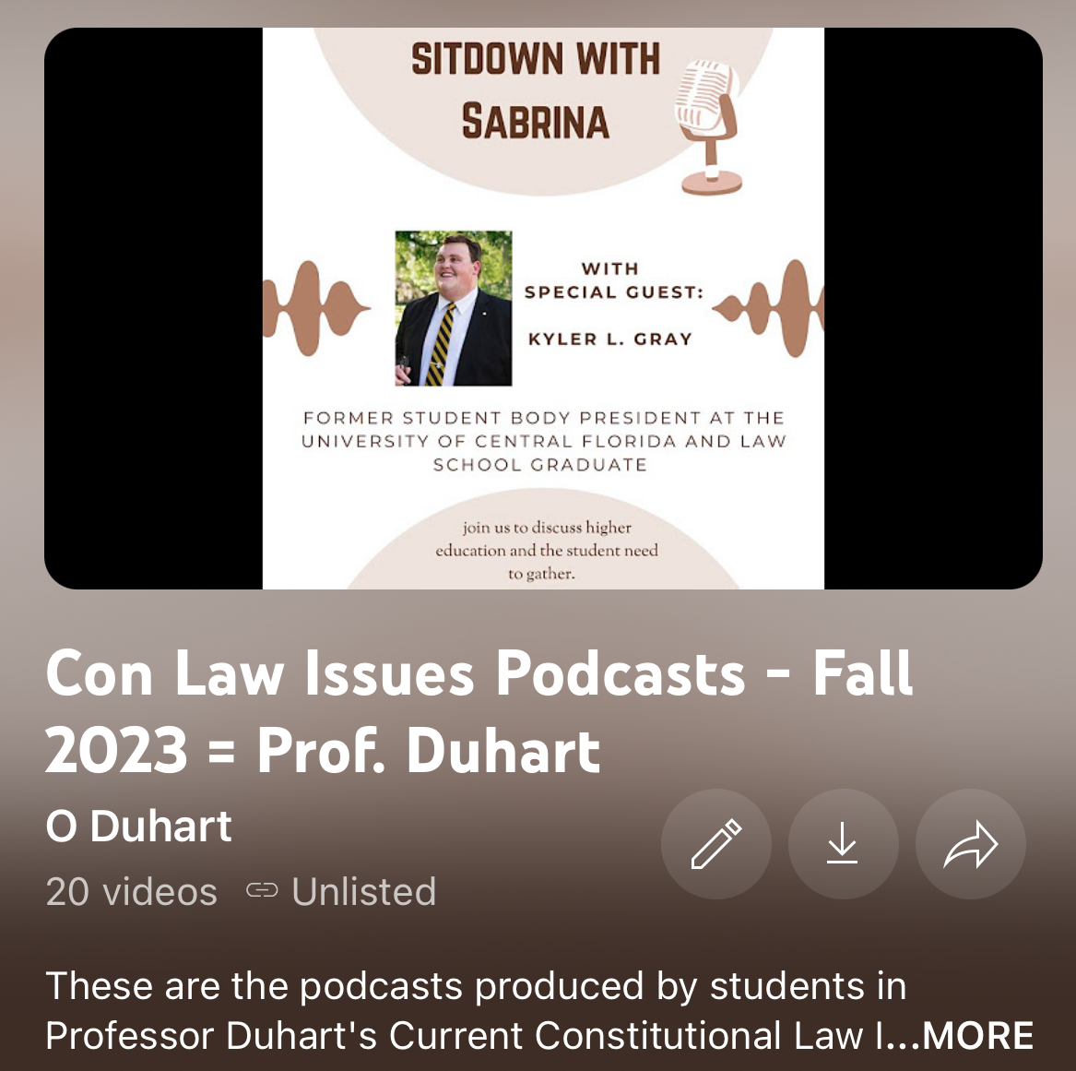

Slide 28
Community

Slide 29
Excerpt from Day One Memo in Constitutional Law:
21. If there is anything I can do to make your law school experience more fulfilling for you, please let me know. Constitutional Law is a demanding course, but it can be very rewarding. Your comments, input and suggestions are appreciated. I will treat you with consideration and respect, and I expect the same from you.

Slide 30
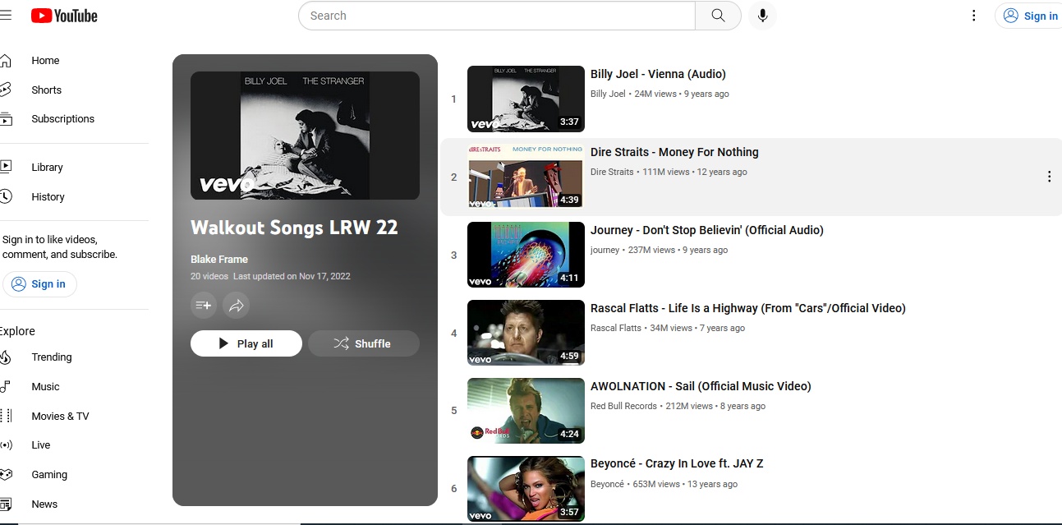

Slide 31
Inclusive Teaching: Micro-inclusions
Address the world around us
Refer to diverse populations in course materials, hypos, PPT images
Use fact patterns featuring people form various socio-economic backgrounds
Demand and model sensitivity and respect for diverse viewpoints and various learning styles
Consider the additional and careful work required

Slide 32
Duhart’s
LRW Lounge
Thursday
Feb. 17
6 p.m.- Midnight
Admission: One “Draft”

Slide 33
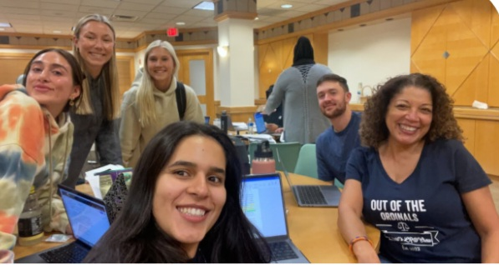

Slide 34
Cellphone: (954) 532-8548

Slide 35
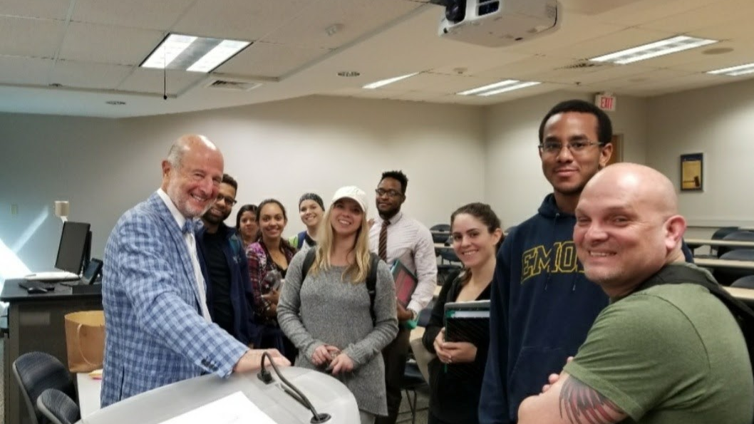
Notes:
Guest speakers

Slide 36
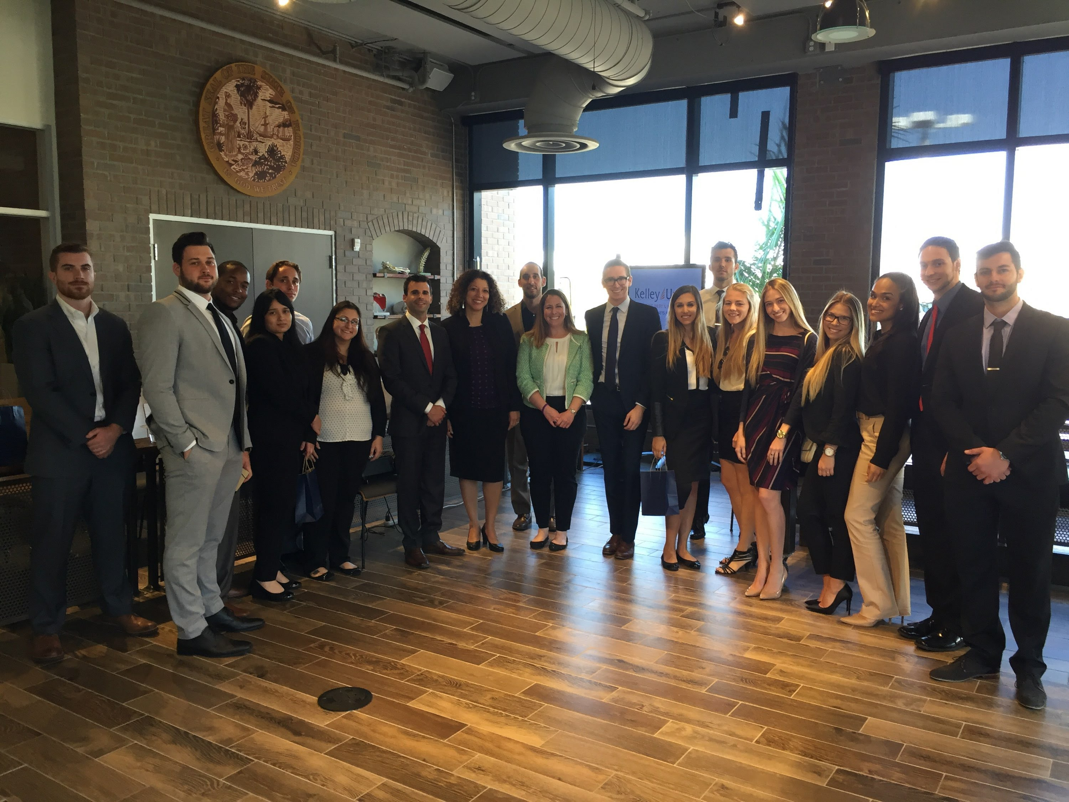

Slide 37
Self-Care
“Given the positive responses – more motivation, better content connections, a stronger sense of the class as a community and fewer classroom management issues – it is not surprising that teachers also benefit when they share power with students.”
---Maryellen Weimer, Learner-Centered Teaching

Slide 38
Brainstorming Activity

Slide 39
How can you create a culture of caring in your classroom?
Notes:
Review padlet results; Update

Slide 40
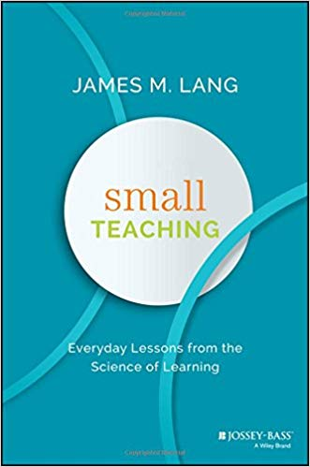

Slide 41
“The academy is not paradise. But learning is a place where paradise can be created. The classroom, with all its limitations, remains a location of possibility.”
-- bell hooks, Teaching to Transgress

Slide 42
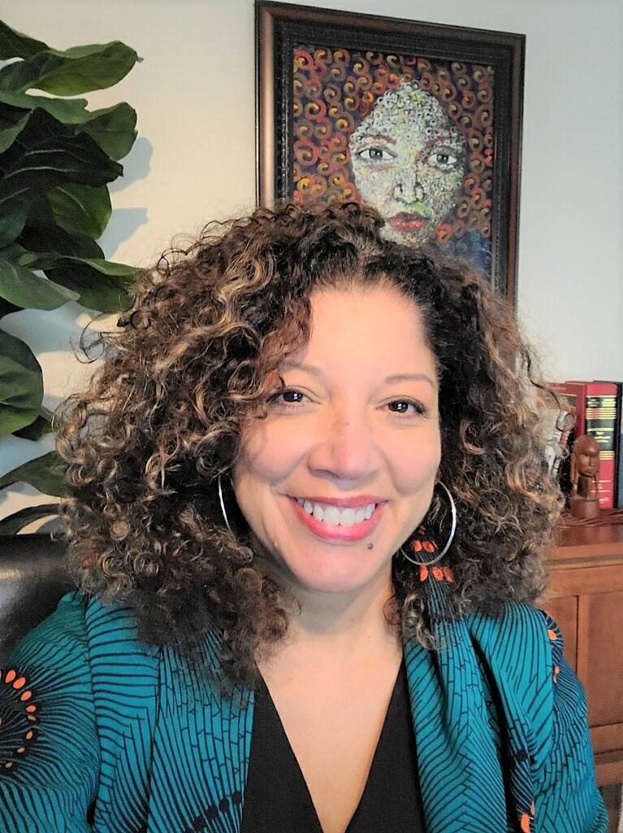
Olympia Duhart
Professor of Law
Associate Dean of Academic Affairs & Strategic Initiatives
Nova Southeastern University
Shepard Broad College of Law
olympia@nova.edu

